Slide 1
User Interface Design

Slide 2
Interface Design
Areas of concern
The design of interfaces between software components
The design of interfaces between the software and other nonhuman producers and consumers of information (i.e., other external entities)
The design of the interface between a human (i.e., the user) and the computer
UID

Slide 3

User Interface Design
Easy to learn?
Easy to use?
Easy to understand?

Slide 4

Interface Design
Typical Design errors
Lack of consistency
Too much memorization
No guidance / help
No context sensitivity
Poor response
Arcane/unfriendly
Arcane : Secret, Mystic

Slide 5
Need of UI Design
User interface design creates an effective communication medium between a human and a computer.
Following a set of interface design principles, design(er) identifies interface objects and actions and then creates a screen layout that forms the basis for a user interface prototype.

Slide 6
What user wants?
“What I really would like,” said the user solemnly, “is a system that reads my mind. It knows what I want to do before I need to do it and makes it very easy for me to get it done. That’s all, just that.”
-- Reply of a user was asked about the attributes of the window-oriented graphical interface needed by the information system

Slide 7
Golden Rules
Place the user in control
Reduce the user’s memory load
Make the interface consistent

Slide 8
Place the User in Control
Avoid unnecessary or undesired actions.
spell checker, debug errors, showing an error message or a home page repeatedly etc.
Provide for flexible interaction.
Keyboard, Mouse, Pen, Voice, Actions etc.
Allow user interaction to be interruptible and undoable.
Make sure – no loss of data already worked

Slide 9
Place the User in Control (contd.)
Streamline interaction as skill levels advance and allow the interaction to be customized.
Expert users, unattended workings, macros
Hide technical internals from the casual user.
Design for direct interaction with objects that appear on the screen.
Give the user real world feel and sense of control.
Allow manipulation of objects on screen (stretch, skew, rotation etc.)

Slide 10
Reduce the User’s Memory Load
Principles :
Reduce demand on short-term memory.
Establish meaningful defaults.
Define shortcuts that are intuitive.
The visual layout of the interface should be based on a real world metaphor.
Disclose information in a progressive (Hierarchical) fashion.

Slide 11
Make the Interface Consistent
Guidelines :
All visual information should be organized according to a design standard that is maintained throughout all screen displays.
Input mechanisms should be constrained to a limited set that are used consistently throughout the application.
Mechanisms for navigating from task to task should be consistently defined and implemented.

Slide 12
Make the Interface Consistent
Principles :
Allow the user to put the current task into a meaningful context.
Window titles, graphical icons etc that enable the user to know the context of the work at hand.
User should be able to determine where he has come from and what alternatives exist for a transition to a new task.
Maintain consistency across a family of applications.
If past interactive models have created user expectations, do not make changes unless there is a compelling reason to do so.
E.g. do not use ctrl + s for scaling

Slide 13
User Interface Design Models
User model
A profile of all end user requirements of the system
Created by “Human Engineer” (or Software Engineer)
Design model
Design realization of the user model
Created by Software Engineer
Mental model (system perception)
The user’s mental image of what the interface is
Implementation model
Created by implementers
The role of interface designer is to reconcile the differences in these models and derive a consistent representation of the interface.

Slide 14
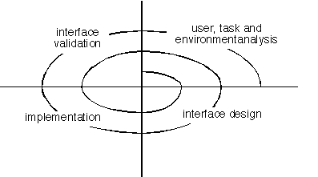
User Interface Design Process

Slide 15
Interface Analysis
Interface analysis means understanding
The people (end-users) who will interact with the system through the interface;
The tasks that end-users must perform to do their work,
The content that is presented as part of the interface
The environment in which these tasks will be conducted.

Slide 16
User Analysis
Can be done through :
User interviews
Sales Team Input
Marketing Team Input
Support Team Input

Slide 17
User Analysis
Are users trained professionals, technician, clerical, or manufacturing workers?
What level of formal education does the average user have?
Are the users capable of learning from written materials or have they expressed a desire for classroom training?
Are users expert typists or keyboard phobic?
What is the age range of the user community?
Will the users be represented predominately by one gender?
How are users compensated for the work they perform?
Do users work normal office hours or do they work until the job is done?
Is the software to be an integral part of the work users do or will it be used only occasionally?
What is the primary spoken language among users?
What are the consequences if a user makes a mistake using the system?
Are users experts in the subject matter that is addressed by the system?
Do users want to know about the technology the sits behind the interface?

Slide 18
Task Analysis and Modeling
Task Analysis answers the following questions …
What work will the user perform in specific circumstances?
What tasks and subtasks will be performed as the user does the work?
What specific problem domain objects will the user manipulate as work is performed?
What is the sequence of work tasks—the workflow?
What is the hierarchy of tasks?
Use-cases define basic interaction
Task elaboration refines interactive tasks
Object elaboration identifies interface objects (classes)
Workflow analysis defines how a work process is completed when several people (and roles) are involved

Slide 19
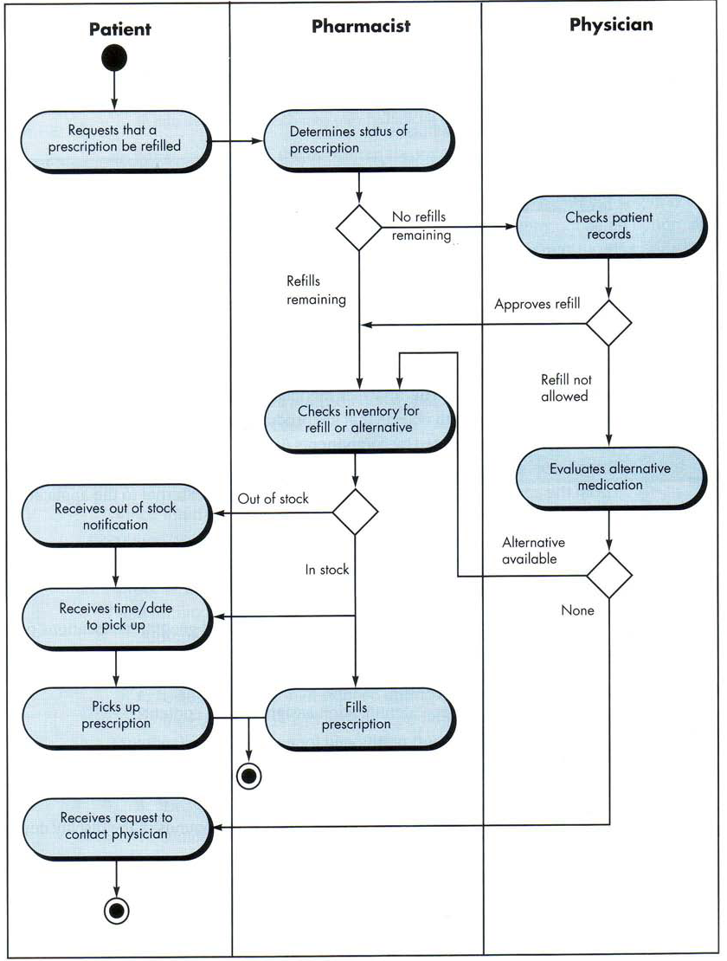
Evaluating Task Hierarchy

Slide 20
Analysis of Display Content
Format and Aesthetics of the contents are considered
Are different types of data assigned to consistent geographic locations on the screen (e.g., photos always appear in the upper right hand corner)?
Can the user customize the screen location for content?
Is proper on-screen identification assigned to all content?
If a large report is to be presented, how should it be partitioned for ease of understanding?
Will mechanisms be available for moving directly to summary information for large collections of data.
Will graphical output be scaled to fit within the bounds of the display device that is used?
How will color to be used to enhance understanding?
How will error messages and warning be presented to the user?

Slide 21
Environment
Ergonomics
The study of work and workplace design.
It is about things that make working on a computer more comfortable and better for human body.
E.g. good UI design may help in avoiding stress and fatigue.

Slide 22
Interface Design Steps
Using information developed during interface analysis, define interface objects and actions (operations).
Define events (user actions) that will cause the state of the user interface to change. Model this behavior.
Depict each interface state as it will actually look to the end-user.
Indicate how the user interprets the state of the system from information provided through the interface.

Slide 23
Design Issues
Response time
Help facilities
Error handling
Menu and command labeling
Application accessibility
Internationalization

Slide 24
Design Issues : Response Time
Length : If the length of system response is too long, user frustration and stress is the inevitable result.
Variability : Variability refers to the deviation from average response time

Slide 25
Design Issues : Help facilities
Will help be available for all system functions and at all times during system interaction?
help for only a subset of all functions and actions, or
help for all functions
How will the user request help?
a help menu,
a special function key, or
a HELP command.
How will help be represented?
a separate window,
a reference to a printed document (less than ideal), or
a one- or two-line suggestion produced in a fixed screen location.

Slide 26
Design Issues : Help facilities
How will the user return to normal interaction?
a return button displayed on the screen
a function key, or
control sequence.
How will help information be structured?
a "flat" structure in which all information is accessed through a keyword
a layered hierarchy of information that provides increasing detail as the user proceeds into the structure, or
the use of hypertext

Slide 27
Design Issues : Error Handling
The message should describe the problem in language that the user can understand.
The message should provide constructive advice for recovering from the error.
The message should indicate any negative consequences of the error (e.g., potentially corrupted data files) so that the user can check to ensure that they have not occurred (or correct them if they have).
The message should be accompanied by an audible or visual cue.
The message should be "nonjudgmental." That is, the wording should never place blame on the user.

Slide 28
Design Issues : Menu and Command Labeling
Will every menu option have a corresponding command?
What form will commands take?
Options include a control sequence (e.g., alt-P),
function keys, or
a typed word.
How difficult will it be to learn and remember the commands?
What can be done if a command is forgotten?
Can commands be customized or abbreviated by the user?

Slide 29
Design Issues : Application Accessibility
People with physical needs
Visual
Hearing
Mobility
Speech
Learning
Follow “assistive technology” guidelines

Slide 30
Design Issues : Internationalization
Localities
Languages

Slide 31
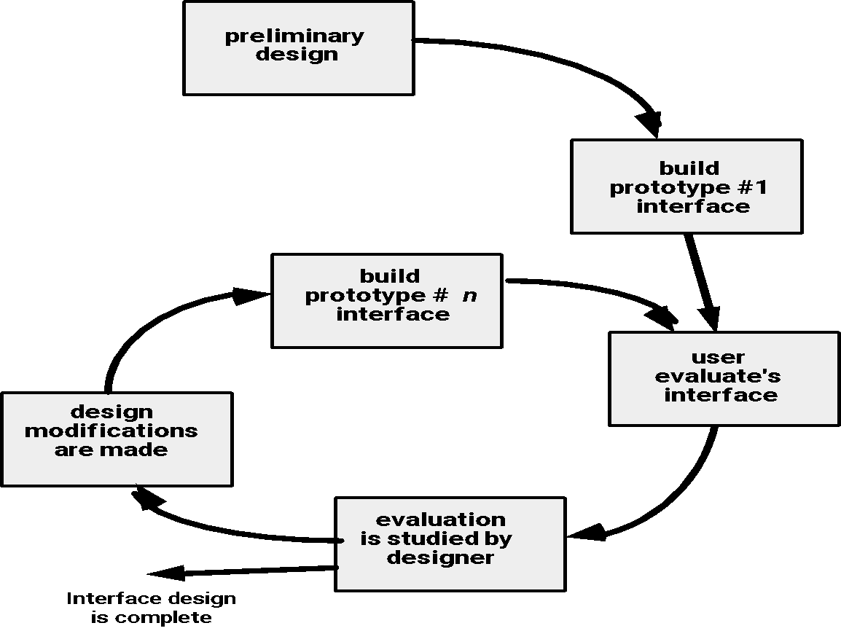
Design Evaluation Cycle

Slide 32
End

